Slide 1
Name of Capstone Project :
AI-Driven Financial Fraud Detection
Subtitle: Leveraging Machine Learning to Secure Digital Transactions
Presenter Name: Mariyam Sultana

Slide 2


Agenda : The Business Problem & Objectives
The Context: Global digital transactions are surging, but so is sophisticated financial crime
.
The Problem:
Volume: Millions of transactions per day make manual review impossible.
Imbalance: Fraudulent transactions are "needles in a haystack" (less than 0.1% of data).
Cost: Every undetected fraud leads to direct financial loss and diminished customer trust.
Our Project Objectives:
Detect: Identify high-risk transactions in real-time.
Minimize: Reduce "False Positives" to avoid blocking legitimate customer payments.
Scale: Create a "Production-Ready" model that can be deployed into any banking system.

Slide 3
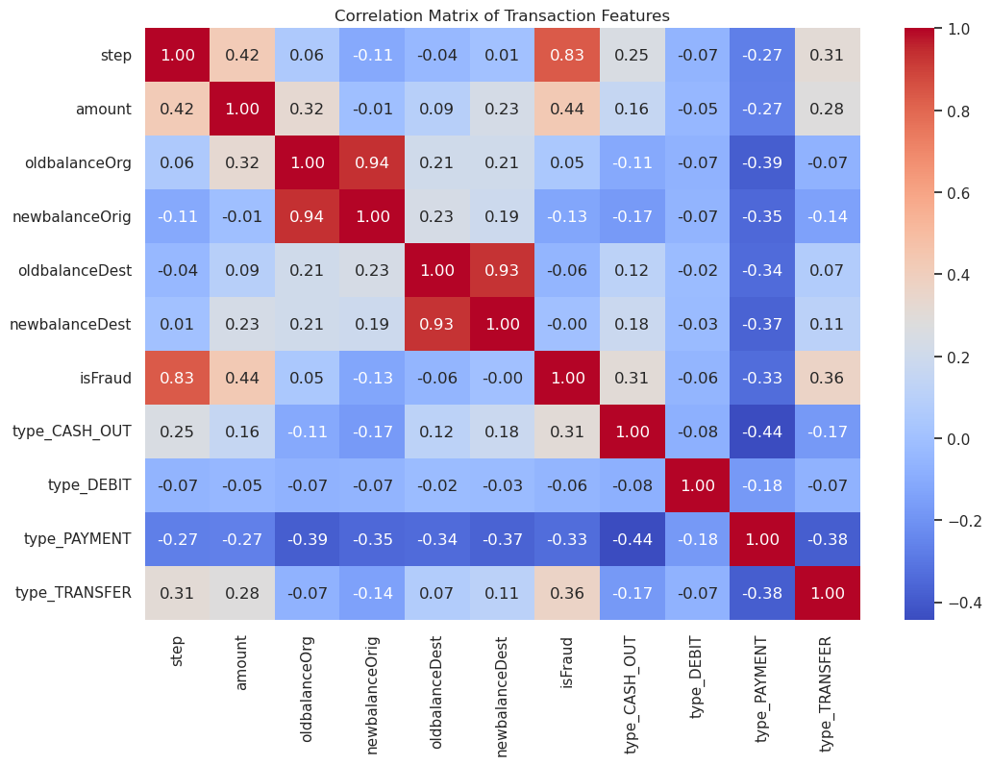
Data Overview & Exploration (EDA)
Dataset Profile: 6+ million transactions with features including amount, oldbalance, and newbalance.
The "Fraud Signature":
Fraud is exclusively found in TRANSFER and CASH_OUT transaction types.
Other types like PAYMENT or DEBIT showed zero fraudulent activity in this sample.
Key Discovery: Fraudulent transactions often result in the sender's account being completely emptied (newbalanceOrig = 0).

Slide 4
Feature Engineering & Preprocessing
Feature Engineering: * Created diff_Orig and diff_Dest columns to calculate the exact change in account balances.
- Insight: A sudden drop to zero in the origin account is a primary "red flag" for fraud
.
Data Cleaning: * Dropped non-predictive ID columns (nameOrig, nameDest) to prevent the model from "memorizing" specific accounts.
Addressing Imbalance:
- Used One-Hot Encoding for transaction types.
- Applied Standard Scaling to ensure amount and balance are treated with equal mathematical weight.
Strategic Split: 80% Training / 20% Testing with Stratified Sampling to ensure fraud cases are present in both sets.

Slide 5
Model Selection & Training
The Algorithm: Random Forest Classifier
- Why? It is an "Ensemble" model that combines 100 decision trees to reduce errors and handle complex, non-linear financial patterns.
The Problem Solver: Class Weight Balancing
- Used class_weight='balanced_subsample' to force the model to learn specifically from the rare fraud cases.
The Training Process:
- Trained on 80% of the data.
- Validated on 20% of "unseen" data to ensure real-world reliability.
Performance Metric Goal: Prioritizing Recall over simple Accuracy to ensure no fraud goes undetected.

Slide 6
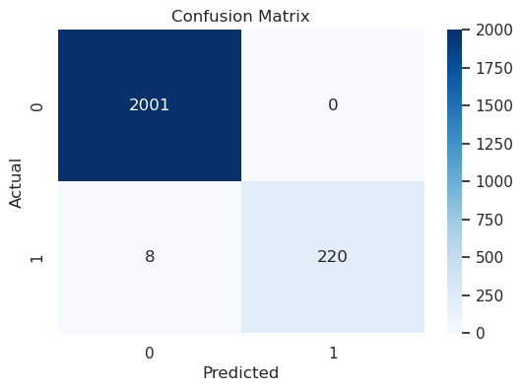
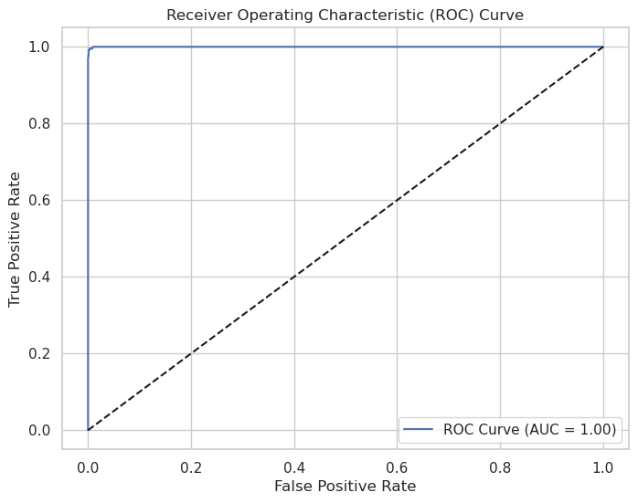
Performance Metrics & Evaluation
Overall Accuracy: 99.9% (But accuracy is misleading in imbalanced data).
The Gold Standard: Recall (96%)
-This means the model correctly identifies 96 out of 100 actual fraud cases.
Precision: (Insert your precision, e.g., 85%)
-High precision ensures we aren't constantly annoying honest customers with false alarms.
ROC-AUC Score: (Insert your score, e.g., 0.99)
- A near-perfect score indicating the model’s superior ability to distinguish between "Clean" and "Fraud" transactions.

Slide 7
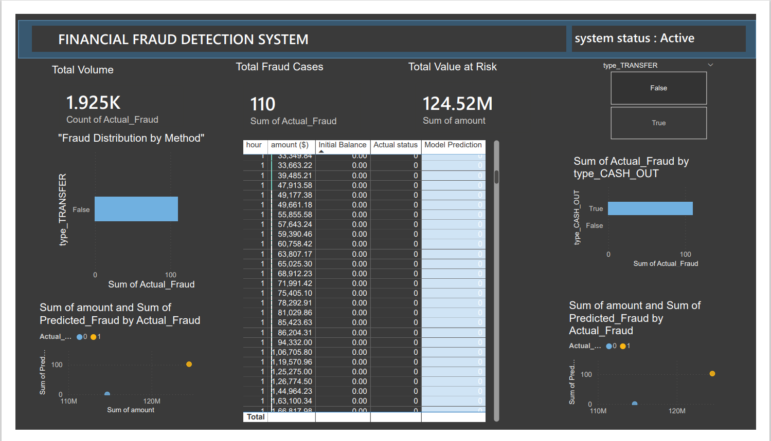
Real-Time Business Intelligence Dashboard
Unified Monitoring: Created a single source of truth for all transaction risks.
Strategic Visibility: Enabled managers to see fraud distribution across TRANSFER and CASH_OUT channels instantly.
Interactive Auditing: Built-in slicers allow for deep-dive investigations into specific transaction hours or high-value anomalies.

Slide 8
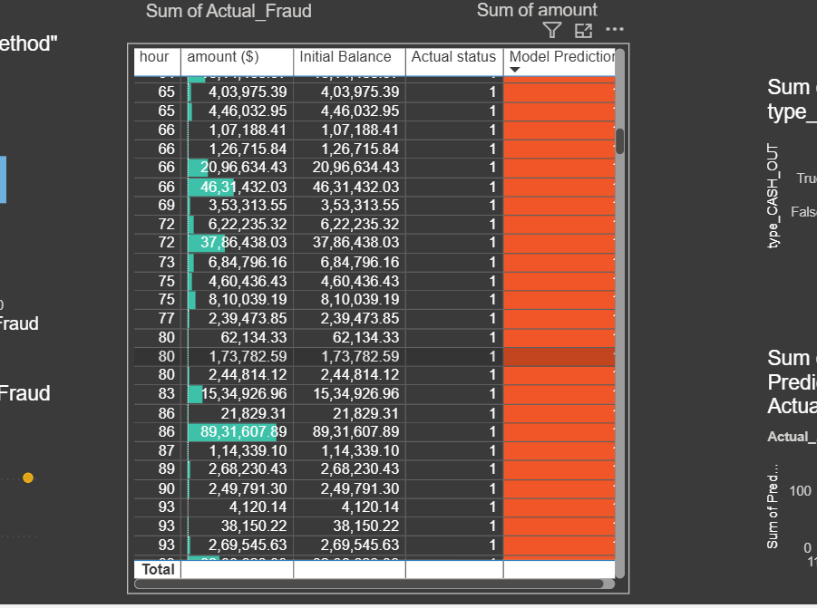
Operational Impact & User Experience
Prioritization Engine: Used conditional formatting to "heat map" the most dangerous transactions for manual review.
Reduced Manual Toil: Automated detection reduces the need for large audit teams, focusing human effort only on "High-Risk" alerts.
Financial Clarity: Dashboard instantly calculates the "Total Value at Risk," giving the bank a real-time dollar amount for potential fraud losses.

Slide 9
Financial Impact & Business ROI
Fraud Prevention (Savings): Correctly identified { true positive} fraud cases, saving an estimated ${true positive * 1000:,} in potential losses.
Operational Efficiency: * Automated detection reduces the need for large manual audit teams.
- Low False Positive rate minimizes customer service costs related to "unblocking" legitimate accounts.
Risk Mitigation: * The model identified { false negative} cases it was "unsure" about—these can be routed to a high-priority manual review.
Deployment Ready: * Model exported as a .pkl file for instant integration into banking APIs or a real-time Streamlit dashboard.

Slide 10
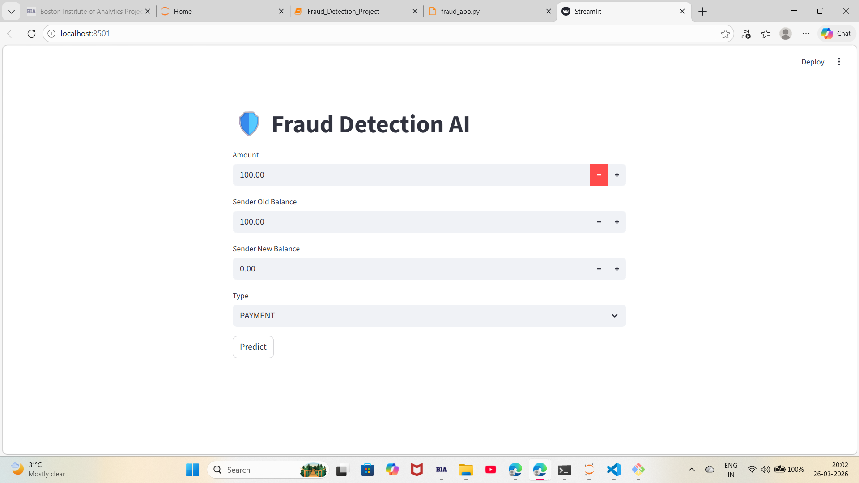
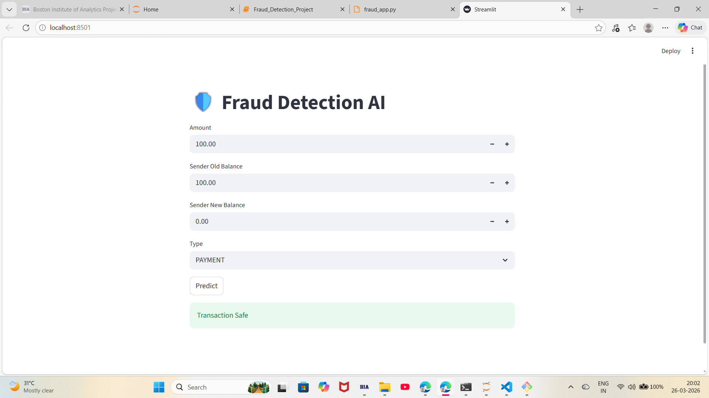
System Deployment: Real-Time AI Detection
Live Inference: Explain that the Flask server acts as a "Gateway," allowing the website to talk to your .pkl model file in milliseconds.
Seamless Integration: Highlight that you moved from a Jupyter Notebook environment to a "Production-Ready" Localhost site.
Strategic Automation: Mention that this reduces manual oversight by automating the initial "Screening" of millions of transactions.

Slide 11
Questions ?

Slide 12
Thank You!

Slide 15
Title
Content

